Slide 1
Weightless Neural Networks for Depth Map Estimation
Weightless Neural Networks (WNN's)
Image Sampling
Depth Map Estimation
Network Architecture
Current Results
Further Research

Slide 2
Weightless Neural Networks
Traditional perceptron neurons perform a biased weighted sum on input sets, followed by the application of an activation function to calculate the final output
X1
X2
.
.
.
Xn
1
w1
w2
Σ
Φ(.)
...
Y
wn
B

Slide 3
Weightless Neural Networks
In contrast, weightless neurons match input bit strings to a set of stored known inputs, returning the response associated to the closest known input
x
1
0
1
i1
1
1
0
d = 2
o1
“dog“
i2
0
0
1
d = 1
o2
“cat“
“cat“
i3
0
1
0
d = 3
o3
“beetle“

Slide 4
Weightless Neural Networks
In principle, as long as a domain X can be mapped to a set of bit strings of some finite length r, weightless neurons could model a function from X to an image Y regardless of what other properties both sets may or may not have
Once the data is available, training a weightless neuron is just a matter of writing entries to its internal memory
X |  |  | Y
Barks | Likes water | Has whiskers | Name
Yes | Yes | No | dog
No | No | Yes | cat
No | Yes | No | beetle
i1
1
1
0
o1
“dog“
i2
0
0
1
o2
“cat“
i3
0
1
0
o3
“beetle“

Slide 5
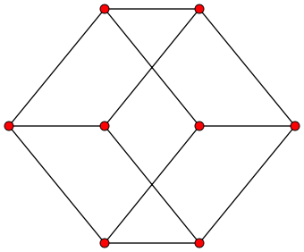
Weightless Neural Networks
In practice, it can be hard to devise a suitable mapping
Mapping some arbitrary set X to the set of bit strings of length r essentially means to assign each element to a vertex of the unit hypercube of dimension r
(1, 1, 0) “dog“
(0, 1, 0) “beetle“
(1, 0, 1) x
(0, 0, 0)
(0, 0, 1) “cat“

Slide 6
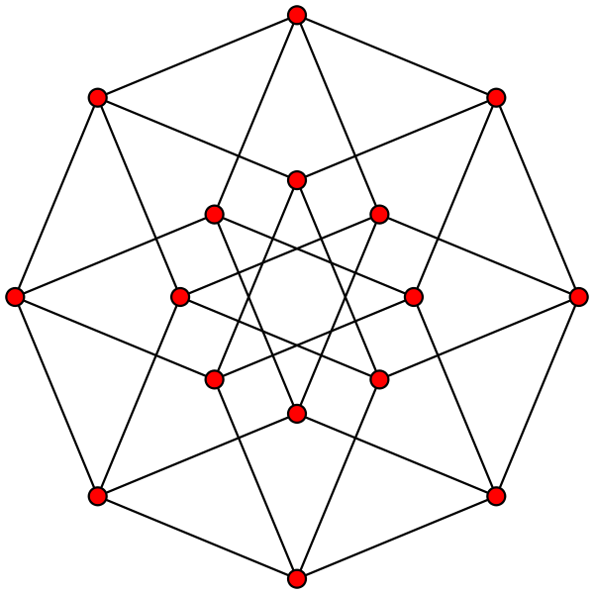
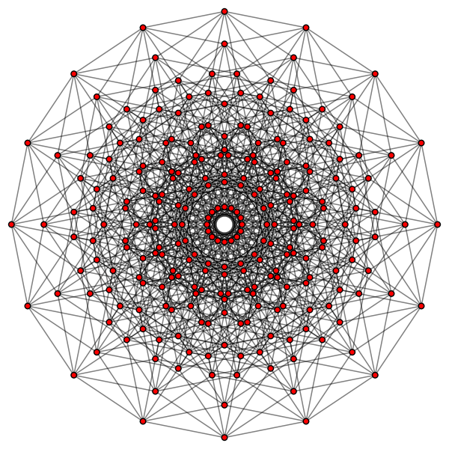
Weightless Neural Networks
As r increases, the number of distinct elements that can be represented grows, but so does the complexity of the space

Slide 7
Weightless Neural Networks
Increasing r also impacts a weightless neuron's response time: using a naive search algorithm, discovering the known input ik which is closer to x takes θ(rn), where r is the length of the bit strings and n the number of known cases
Therefore, the speed of weightless neurons is impacted both by the number of known cases they need to store in order to enable sufficient accuracy, and the length of the bit strings they use to represent inputs (i.e. the curse of dimensionality)

Slide 8
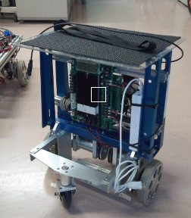
Image Sampling
Each pixel in an RGB image takes 24 bits
A patch as small as 16x16 pixels contains 6144 bits
Curse you dimensionality!

Slide 9
Image Sampling
Sampling can be used to avoid the curse of dimensionality
How the human visual system processes images?
  Photo-receptors are either Cones (which sense different color ranges) or Rods (which are only sensitive to light intensity)
  Photo-receptor distribution is dense inside the fovea, and more sparse elsewhere
  Retinal neurons record differences between a photo-receptor and its neurons, not absolute values

Slide 10
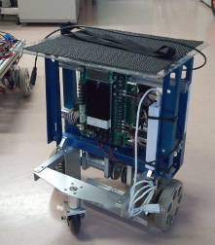
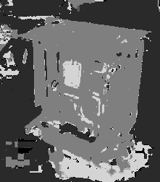
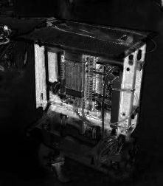
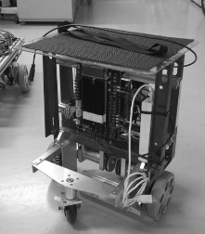
Image Sampling
The channels of the HSL (Hue, Saturation, Lighting) color space provide an analogue to the separation of color and brightness information performed by retinal photo-receptors
H
S
L

Slide 11
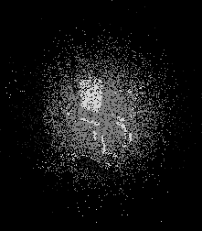
Image Sampling
The distribution of photo-receptors across the fovea can be mirrored by sampling the image with a list of synapses {s1, s2, … , sk, … , sn} distributed in a Gaussian pattern

Slide 12
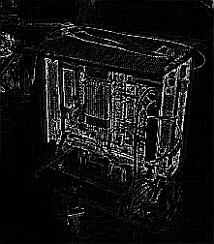
Image Sampling
On-cells are simulated in two steps: first, an edge map is applied to the Lightness channel, adding a further projection to the input
H
S
L
Edges

Slide 13
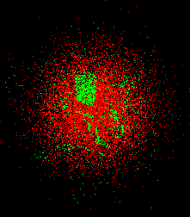
Image Sampling
Second, minchinton cells are used to convert the numeric values reported by the synapses into single bits
A minchinton cell is formed by a pair of synapses (s1, s2)
It returns 1 if value(s1) > value(s2), and 0 otherwise
Out of n synapses, it's possible to form n minchinton cells {(s1, s2), (s2, s3), … , (sk, sk+1), … , (sn-1, sn), (sn, s1)}

Slide 14
Image Sampling
The diagram below summarizes the resulting architecture:
RGB Image
Projections
H
S
L
Edges
Synapses
Minchinton cells
>
>
>
>
>
>
>
>
>
>
>
>
>
>
>
>
b
b
b
b
b
b
b
b
b
b
b
b
b
b
b
b
Input bit string

Slide 15
Image Sampling
Sampling the previous projections using 1024 gaussian-distributed synapses (256 per projection), and converting their outputs to single bits using minchinton cells, produces a bit string of length r = 1024

Slide 16
Image Sampling
The resulting 1024-bit representation of the image can now be used as input to a training weightless neuron, standing in place of the image's original (and much larger) content
10201114040012108208502601544100
8400009a800482082000814201092901
69d6a95dd54a52b2d3485531c9a8a53b
b24cb351a751b05156e2506978b4554d
51af36758a8ed9a99c268184cf356553
bca0db92a76ca2054557566eb8462d96
181245143a0a54298a6a8aba50111596
48511352ea54a90aa96405270e889a04
221x252 pixels
1,336,608 bits
1,024 bits

Slide 17
Depth Map Estimation
Depth Map estimation is the process of deriving the distances from the viewer to elements (ideally, each pixel) in a scene
It can be done directly via a measuring device, e.g. a laser range scanner, or indirectly via an inference system, e.g. a stereo vision rig

Slide 18
Depth Map Estimation
Depth map estimation has applications in:
  Obstacle avoidance
  Landmark recognition
  3D image acquisition
Laser range scanners are often limited to a single horizontal or vertical band (1D)
Vision-based depth estimators can apprehend depth across the width and height of an image (2D)

Slide 19
Depth Map Estimation
Stereo vision rigs explore the disparity between images apprehended by each camera to estimate depth
Such stereo correspondence approaches tend to work poorly for far objects and regions without texture
Monocular depth estimation can complement the input of stereo correspondence systems, improving its performance
It could also be used on its own, with the advantage of a simpler setup (e.g. no need to calibrate a camera pair)

Slide 20
Depth Map Estimation
Ashutosh Saxena's research on Markov Random Fields demonstrated the feasibility of a machine learning approach to depth map estimation on monocular images
Compared to the MRF approach, WNN's could contribute a solution with shorter training times and a more easily parallelizable implementation (to take advantage of the multi- and many-core processors that have become standard across the industry)

Slide 21
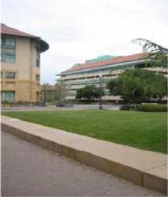
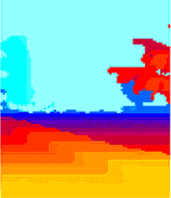
Depth Map Estimation
Weightless Neural Networks can estimate Depth Maps for monocular images by learning relations between image samples (like the ones discussed previously) and depth values from a training database (which must therefore be constructed in some other way)
,
, ...

Slide 22
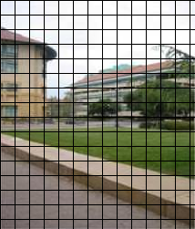
Depth Map Estimation
During training, images are divided in patches
A depth value is assigned to each patch
( , d1)
...
( , dk)
...
( , dn)

Slide 23
Depth Map Estimation
The (patch, depth) pairs are assigned to neurons in the network for training, according to some predefined rule
Each neuron samples the patches it is assigned, storing the resulting bit strings along with the depth values
( , d1)
N1
(b1, d1), ...
...
( , dk)
Ni
(bk, dk), ...
...
( , dn)
Nm
(bn, dn), ...

Slide 24
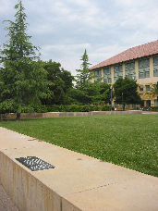
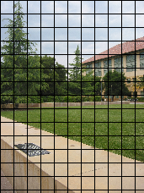
Depth Map Estimation
During testing, images are again divided in patches
Patches are presented to neurons for test, according to the same rule used to distribute the (patch, depth) pairs during training
N1
(b1, d1), ...
Ni
(bk, dk), ...
Nm
(bn, dn), ...

Slide 25
Depth Map Estimation
Neurons sample the patches and search in their memories for the closest match to the resulting bit strings
Neurons return depth values as results for the searches
bx
N1
(b1, d1), ...
dx
...
by
Ni
(bk, dk), ...
dy
...
bz
Nm
(bn, dn), ...
dz

Slide 26
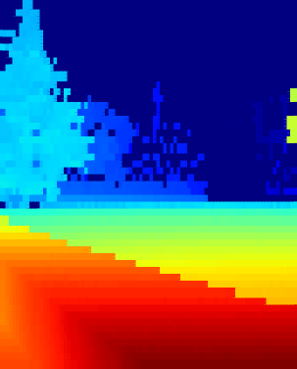
Depth Map Estimation
Depth values are collected in a matrix, which is returned as the estimated depth map
dx
dy
dz
...

Slide 27

Network Architecture
Looking into depth maps, it's often the case that a stack of depth bands can be identified, where bands lower in the image mostly contain lower depth values, and higher ones, higher values

Slide 28

Network Architecture
This suggests a division in the neural network, where different neurons are assigned to specific bands in the image / depth map pair
N1
N2
N3
N4
N5
N6

Slide 29
Network Architecture
In order to add robustness to the system, each band is sampled by several neurons, each with its own unique synaptic layout
N1,1
N1,2
N1,3
N1,4
N2,1
N2,2
N2,3
N2,4
N3,1
N3,2
N3,3
N3,4
N4,1
N4,2
N4,3
N4,4
N5,1
N5,2
N5,3
N5,4
N6,1
N6,2
N6,3
N6,4

Slide 30
Network Architecture
During training, each (patch, depth) pair is dispatched to all neurons assigned to the horizontal band where it is located
During testing, the m neurons on each band will output m estimates for each image patch; the value more often returned will be taken as the final estimate for the patch

Slide 31
Current Results
For this sampling strategy and network architecture, the following parameters have been found to be optimal:
  Neurons: 10 per band
  Synapses: 256 per neuron, gaussian distribution with σ = 40
The data base had the following characteristics:
  Set: 425 (image, depth map) pairs, indoors and outdoors
  Dimensions: images 1704x2272, depth maps 86x107
  Patch dimensions: 19x21
  Training set: 190 pairs (44%)
  Validation set: 94 pairs (22%)
  Test set: 141 pairs (33%)

Slide 32
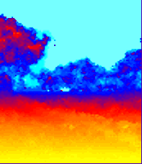
Current Results
Performance of the current architecture is encouraging (both indoors and outdoors) but limited
Estimation of a scene's general outlook is reliable, but finer details (in particular, close objects by the middle of the image) are often missed
Training is fast, but testing is gruesomely slow, taking as much as 10min for a single scene

Slide 33
Further Research
"After a man has finished building his house, only then he knows how he should have done it" (Friedrich Nietzsche)
Several fundamental issues limit the current architecture's performance:
  The linear search algorithm employed by the neurons takes too much time and memory space
  The sampling strategy throws away too much information
  Distributing (patch, depth) pairs across neurons spatially (i.e. by horizontal bands) prevents the system from recognizing an object seen during training in a different band

Slide 34
Further Research
The current linear search algorithm is of complexity θ(rn) (for n bit strings of length r) in both time and space
In contrast, bitwise trie search takes θ(r) time when the exact input bit string is known, and θ(log(rn)) in the worst case where all bit strings have to be examined
As the number of known inputs increases, average search time goes down
Space complexity is θ(log(rn)); each new stored case takes a little less extra space than the previous one

Slide 35
Further Research
x = (1, 0, 1)
0
0
1
"cat"
1
1
0
"dog"
"dog"
d = 2
0
1
0
"beetle"
"cat"
d = 1
0
1
0
1
0
1
0
1
0
1
0
1
"cat"
"beetle"
"dog"

Slide 36

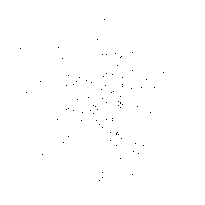
Further Research
Gaussian sampling images in the spatial domain provides no guarantee that the sampled points are expressive

Slide 37
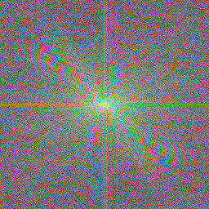


Further Research
Sampling a patch in the frequency domain yields a representation that is both compact and expressive

Slide 38
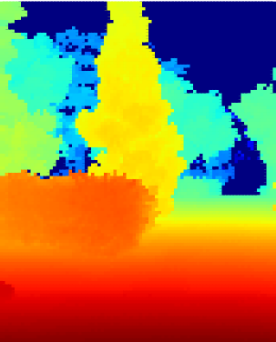
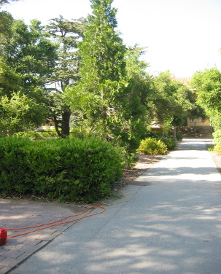
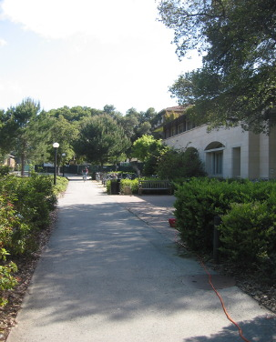
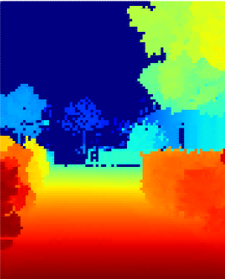
Further Research
Separating patches by spatial position limits the architecture's ability to generalize knowledge
Separating patches by visual features would avoid this restriction

Slide 39
Further Research
A "dispatcher neuron" can classify patches according to overall visual features, directing them to different "processor neurons" tuned to specific feature sets
N1
( , d1)
N2
...
N3
( , dk)
Nd
...
N4
( , dn)
N5
N6

Slide 40
The End
Questions?

